Slide 1
Citi Bike Analytics
Ray Zhang

Slide 2
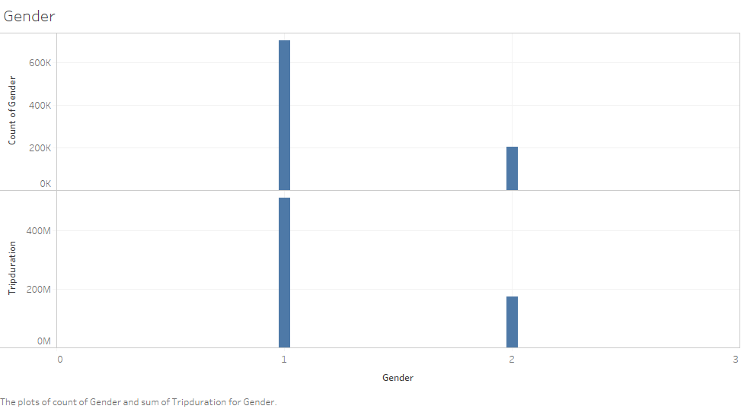
Notes:
There were nearly one million uses of the Citi Bike program in the month of February 2019 alone. Men used the program more frequently than women, making up 77.56% of the uses.
However, when women rode the bikes, they would usually ride for longer than men, with the average woman riding for 14.22 hours, compared to the average man’s riding for 12.15 hours.

Slide 3
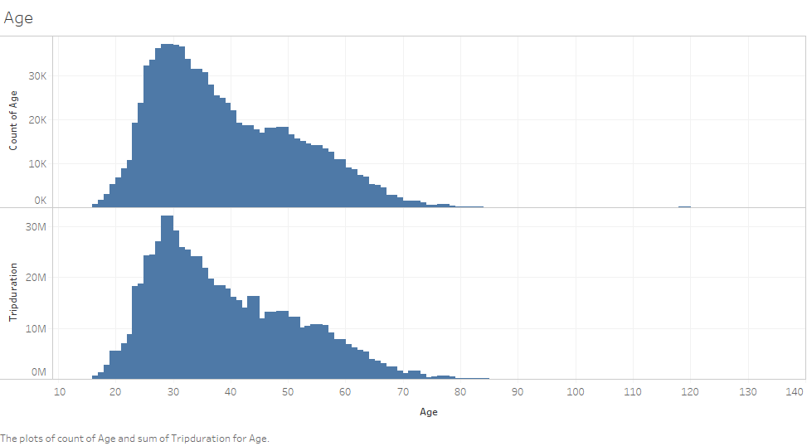
Notes:
The most frequent users of the Citi Bike program were aged between 28 and 31, with a 29-year-olds riding the most. 29-year-olds also rode for longer than most, though there was another peak in trip duration for 44-year-olds.

Slide 4
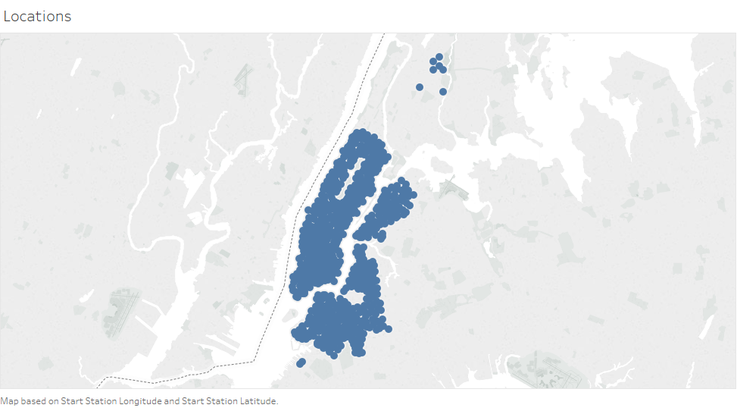
Notes:
The Citi Bike stations are spread fairly consistently throughout New York, excepting areas such as the Brooklyn Navy Yard and Central Park; however, the bulk of the stations do end north of Harlem, with only a few stations scattered around the Bronx.

Slide 5
